Slide 1

Microsoft Ignite NZ
25-28 October 2016
SKYCITY, Auckland

Slide 2
My Other Computer is an Azure Datacentre
Ivan Towlson

Slide 3
Speed matters
Timely data
Rapid feedback
Hard deadlines

Slide 4
What could you do with 100x the scale?
Do more with hyperscale
Get faster results
Run larger simulations / models
Run more projects
Explore new insights (‘what if…’)
Remove limitations
Modify more parameters
Analyse more complex models
Model larger geographic areas
Simulate longer periods of time
Generate higher fidelity results
Run more iterations

Slide 5
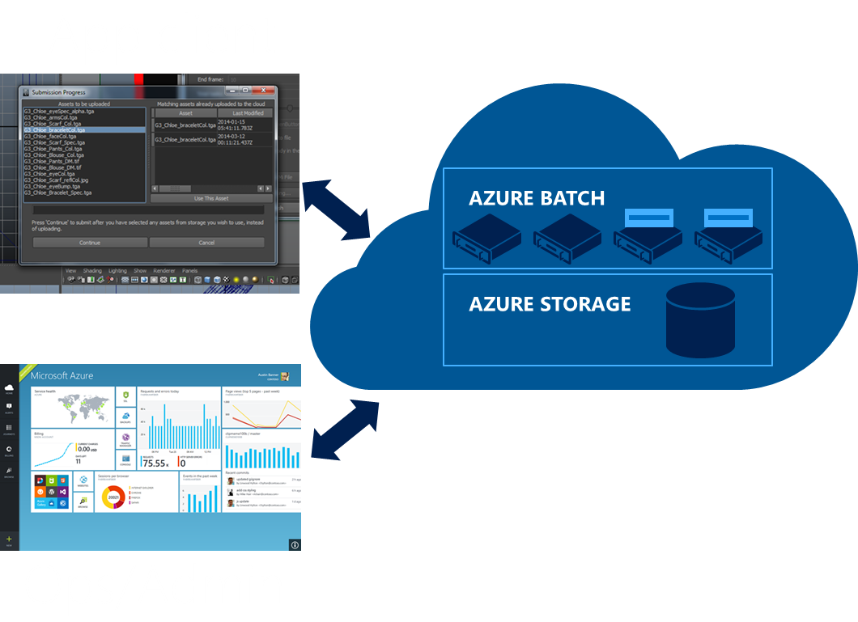
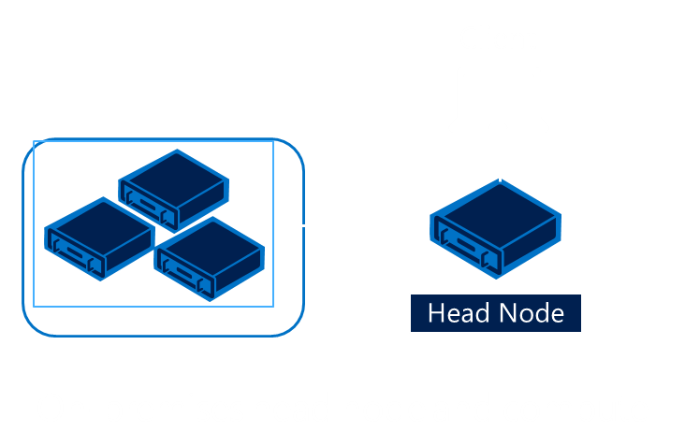
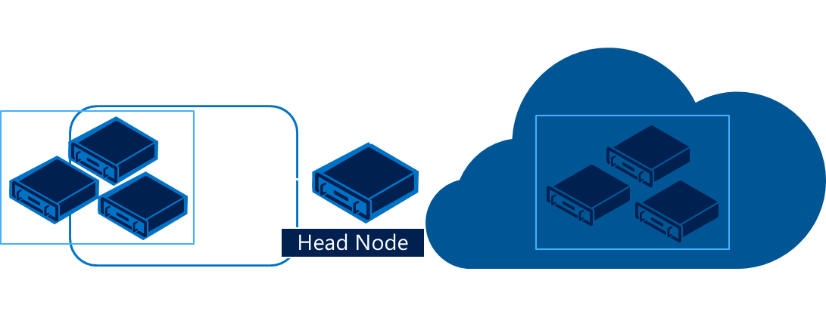
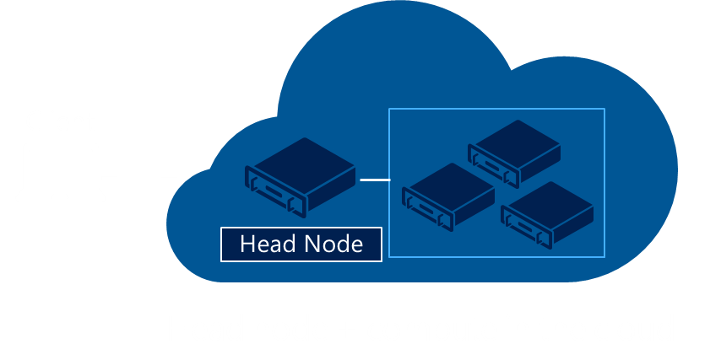
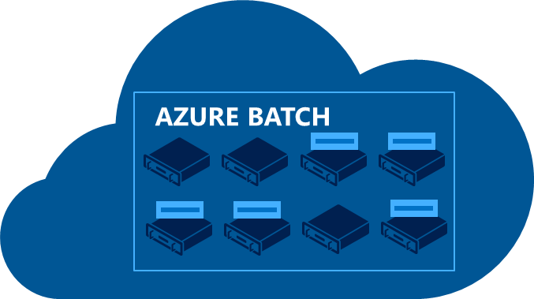
Big Compute solutions at Microsoft
HPC Pack On-premises
Hybrid HPC Cluster
HPC IaaS
Azure Batch
Supports Windows and Linux compute nodes
Advanced job scheduling and resource management
Proved and scale-tested capabilities
Free of charge
Easy to extend to hybrid
Burst to cloud to handle peaks in demand or special projects
Automate the deployment of Windows and Linux Azure VMs
Use your current HPC scheduler or HPC Pack
Pay only for what you use
Deploy a cluster all in the cloud, on demand
Use your current scheduler or HPC Pack
Readily shift existing applications to the cloud
Use templates, scripts, and gallery images to deploy on demand
Cloud-born HPC scheduler
Abstracts infrastructure management
Auto-scaling and stopping
Small to extremely large deployments
Integrate on CLI or client GUI, or on a portal to offer SaaS

Slide 6
Building a solution without Azure Batch
User application or service
Get and manage VMs
Install task applications
Significant amount of infrastructure, not related to business
Manage and authenticate users
Start the tasks
Move task input and output
Queue tasks
Task failure? Task frozen?
Scale up and down
IaaS or PaaS
Standard and custom images
Windows or Linux
PaaS
Cloud Services
IaaS
Virtual Machines
Commodity to high-performance
Small to huge
RDMA network for tightly coupled tasks
Hardware

Slide 7
Building a solution with Azure Batch
User application or service
Azure Batch
Cloud-enable applications, available as SaaS:
Don’t worry about the “plumbing”
Focus on the workload/app
Higher-level capabilities
Minimizes required Azure knowledge
App lifecycle, job dependencies, data movement, user management & authorization, quotas & budget, client plugins
VM management and job scheduling
PaaS
Cloud Services
IaaS
Virtual Machines
Hardware

Slide 8
Patterns
Parametric sweep
Monte Carlo
Divide and conquer
Map-reduce
Genetic algorithms
Search
Analytics and reporting

Slide 9
Usage patterns
Sporadic – on-demand irregular requirements
Cyclical – scheduled daily, weekly, etc.
End of period – very large runs quarterly or yearly
Project – continuing workload for duration of project
Constant – continuing business need

Slide 10
Azure Batch architecture
Jobs and tasks – work to be done
Pools and nodes – where to do that work

Slide 11
Azure Batch architecture
Windows (PaaS and IaaS)
Linux (IaaS)

Slide 12
Azure Batch architecture
Application deployment using packages
Batch Shipyard – deployment via Docker

Slide 13
Azure Batch architecture
Azure portal – admin users, operations
Command line – admin, power users
Azure XPlat CLI
PowerShell
API / libraries – developers
.NET
Java
Python
Node.js
Custom experiences – end users
Web portal
Application GUI integration

Slide 14
Demo
Batch developer experience
I’ll use .NET but other languages are similar
Batch command line admin experience
I’ll use XPlat CLI but PowerShell is similar

Slide 15
Demos
Parallelising work to finish quicker (BLAST)
Distributed deep learning (TensorFlow)

Slide 16
Challenges and lessons learned
Data movement
Inter-node communication
Critical for tightly coupled applications (MPI)
Capacity and spin-up time
Batch vs. interactive
Security boundaries

Slide 17
Ecosystem
Azure Data Factory (orchestration)
Azure Data Lake (big data)
Azure IoT (good candidate for parallel processing)
ExpressRoute (data movement, bridge to on-premise)

Slide 18
Thanks!
Compute tasks don’t have to take ages
Faster turnaround is better for business and people
Many patterns scale naturally out and/or up
More and bigger machines are there for the taking
itowlson@microsoft.com | ivan@hestia.cc
hestia.typepad.com/flatlander | @ppog_penguin
github.com/itowlson/my-other-computer

Slide 19
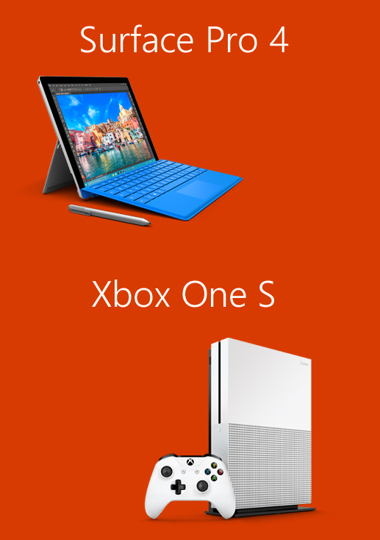
Please evaluate this session for the chance to instantly win great prizes like Surface Pro 4 and the brand new Xbox One S!
Your feedback is important to us!
From your PC or Tablet visit My Ignite at http://msignite.nz/my-ignite

